Slide 1
CHER | 2023 Health Equity Research Intensive
Evaluation Summary
Data as of October 15, 2023

Slide 2
Overall HERI Results

Slide 3
Evaluation Demographics
1 Non-academic staff (2%)
2 Students (5%)
5 Community Members (12%)
6 Research Staff (15%)
9 Faculty (22%)
18 Other (44%)
= 41 sets of responses
Notes:
41 of 55 responses reported demographics.
54 of 55 responded to pre/post learning objectives, 5 session items, 3 domain items

Slide 4
Attendance & Response Rates
Session Name | Registered | Attended | % Attended | Evaluated | Response Rate
Trust and Trustworthiness in Research Engagement | 53 | 47 | (89%) | 9 | (55%)
Equitable Partnerships | 33 | 28 | (85%) | 7 | (43%)
Nuts & Bolts of Community Engagement Across the Research Lifespan | 19 | 17 | (89%) | 6 | (59%)
Community-Based Participatory Research (CBPR) 101 | 27 | 18 | (67%) | 3 | (50%)
Participatory Budgeting | 26 | 18 | (69%) | 5 | (44%)
Role of Research(ers) in Advocacy and Policy Change | 21 | 12 | (57%) | 4 | (8%)
Communicating Health Equity Research Effectively | 32 | 27 | (84%) | 8 | (30%)
Photovoice as a CBPR Tool: Planning, Facilitation, Dissemination, and Sustaining Partnerships | 13 | 10 | (77%) | 2 | (20%)
Community-Clinic Linked Groundwater Approach to Addressing Integrated Needs of Patients in NC | 40 | 24 | (60%) | 4 | (12%)
Climate Change & Environmental Health Considerations for Research | 17 | 6 | (35%) | 5 | (33%)
Co-Lab(orative) Learning Workshop: Supporting Partnership Sustainability for the Long Term | 36 | 20 | (56%) | 1 | (20%)
Notes:
Update the following highlighted in yellow:
# attendees per session (Whova?) https://app.asana.com/0/1201827635749188/1202901905482504/f
Other analytics
Average attendance across all sessions (excluding the welcome session): 68%
Average attendance across all sessions (including the welcome session): 70%
Percent of registrants who attended at least one session: 98% (52 out of 53)

Slide 5

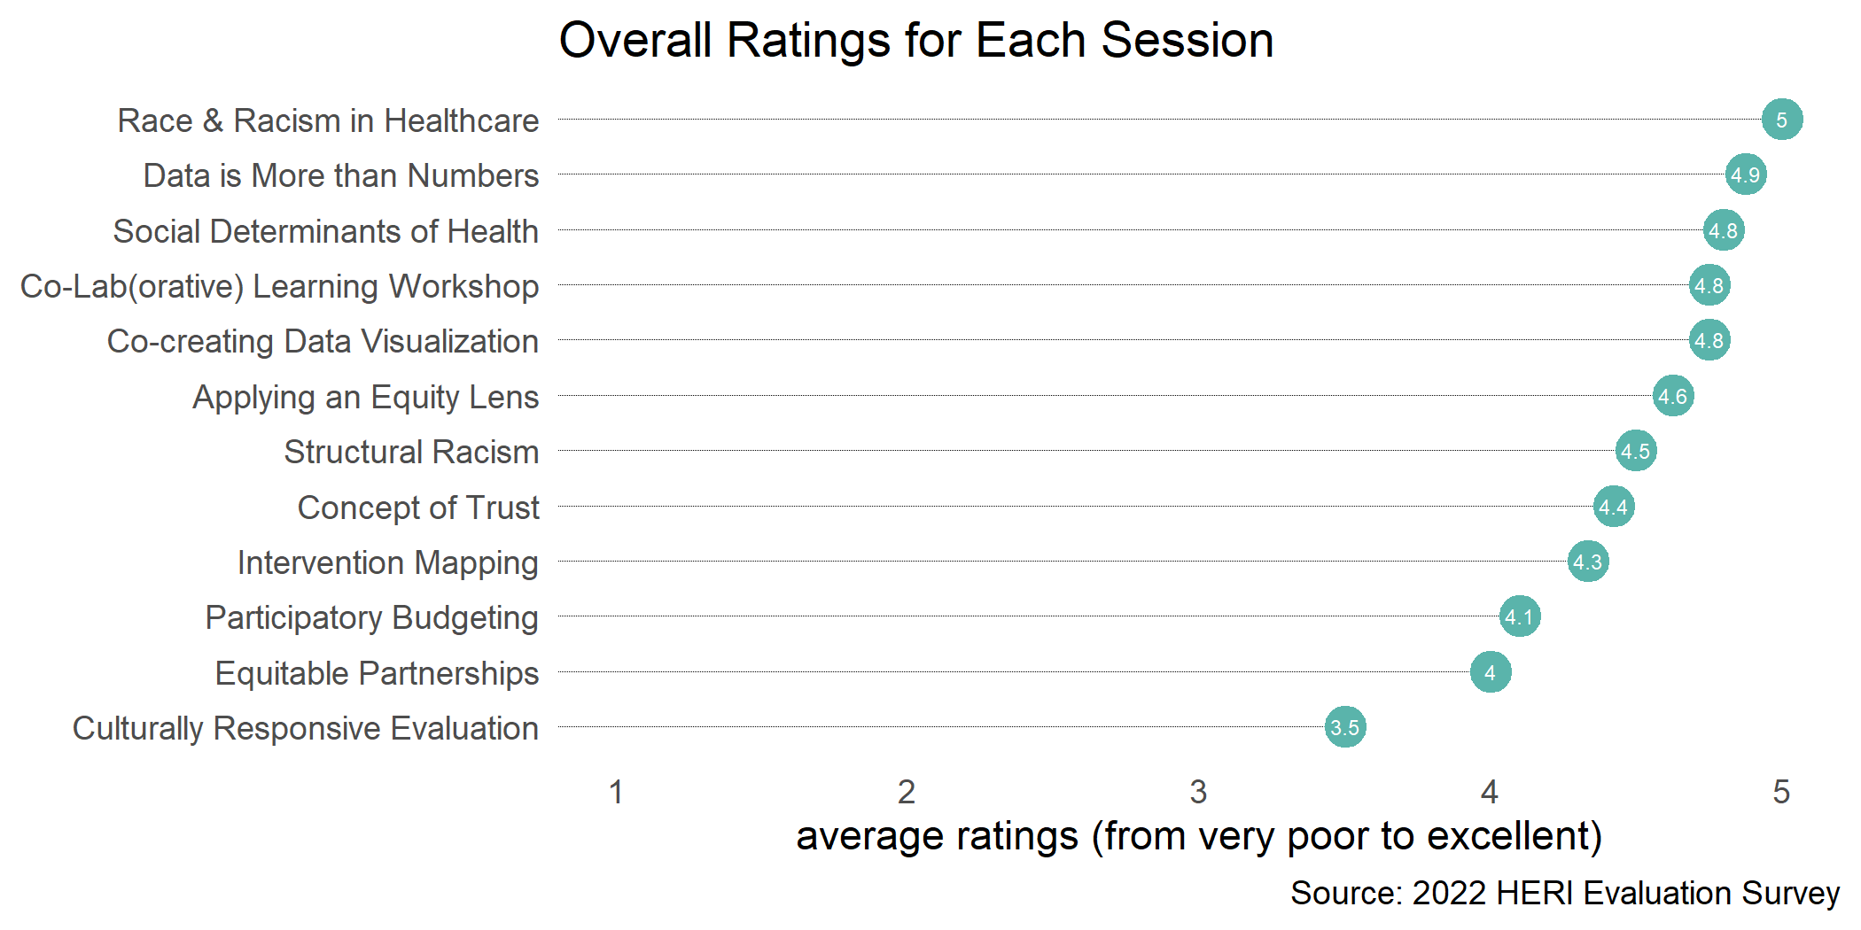
Session Quality
2022 HERI
average rating
4.47
Notes:
Not asked in 2023

Slide 6
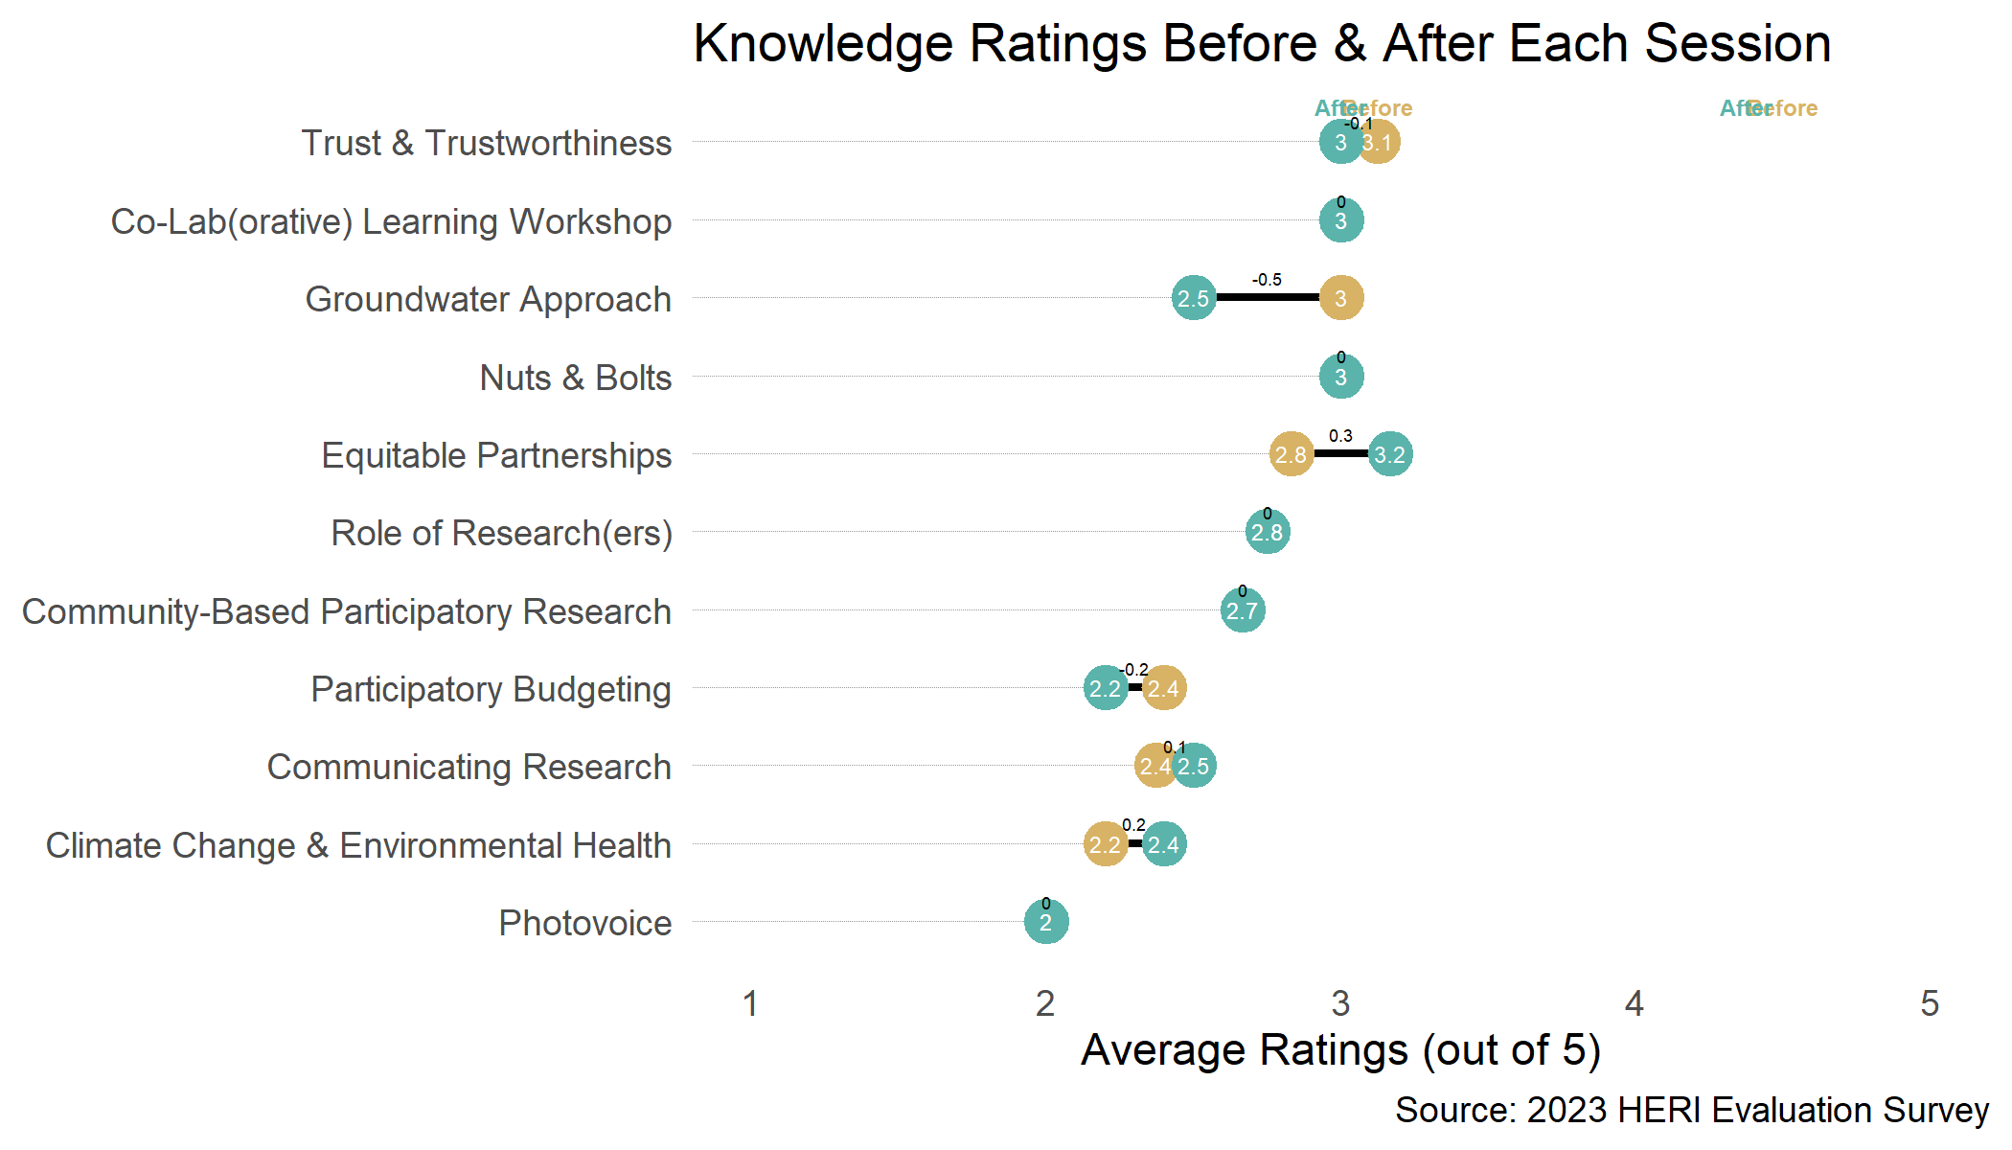
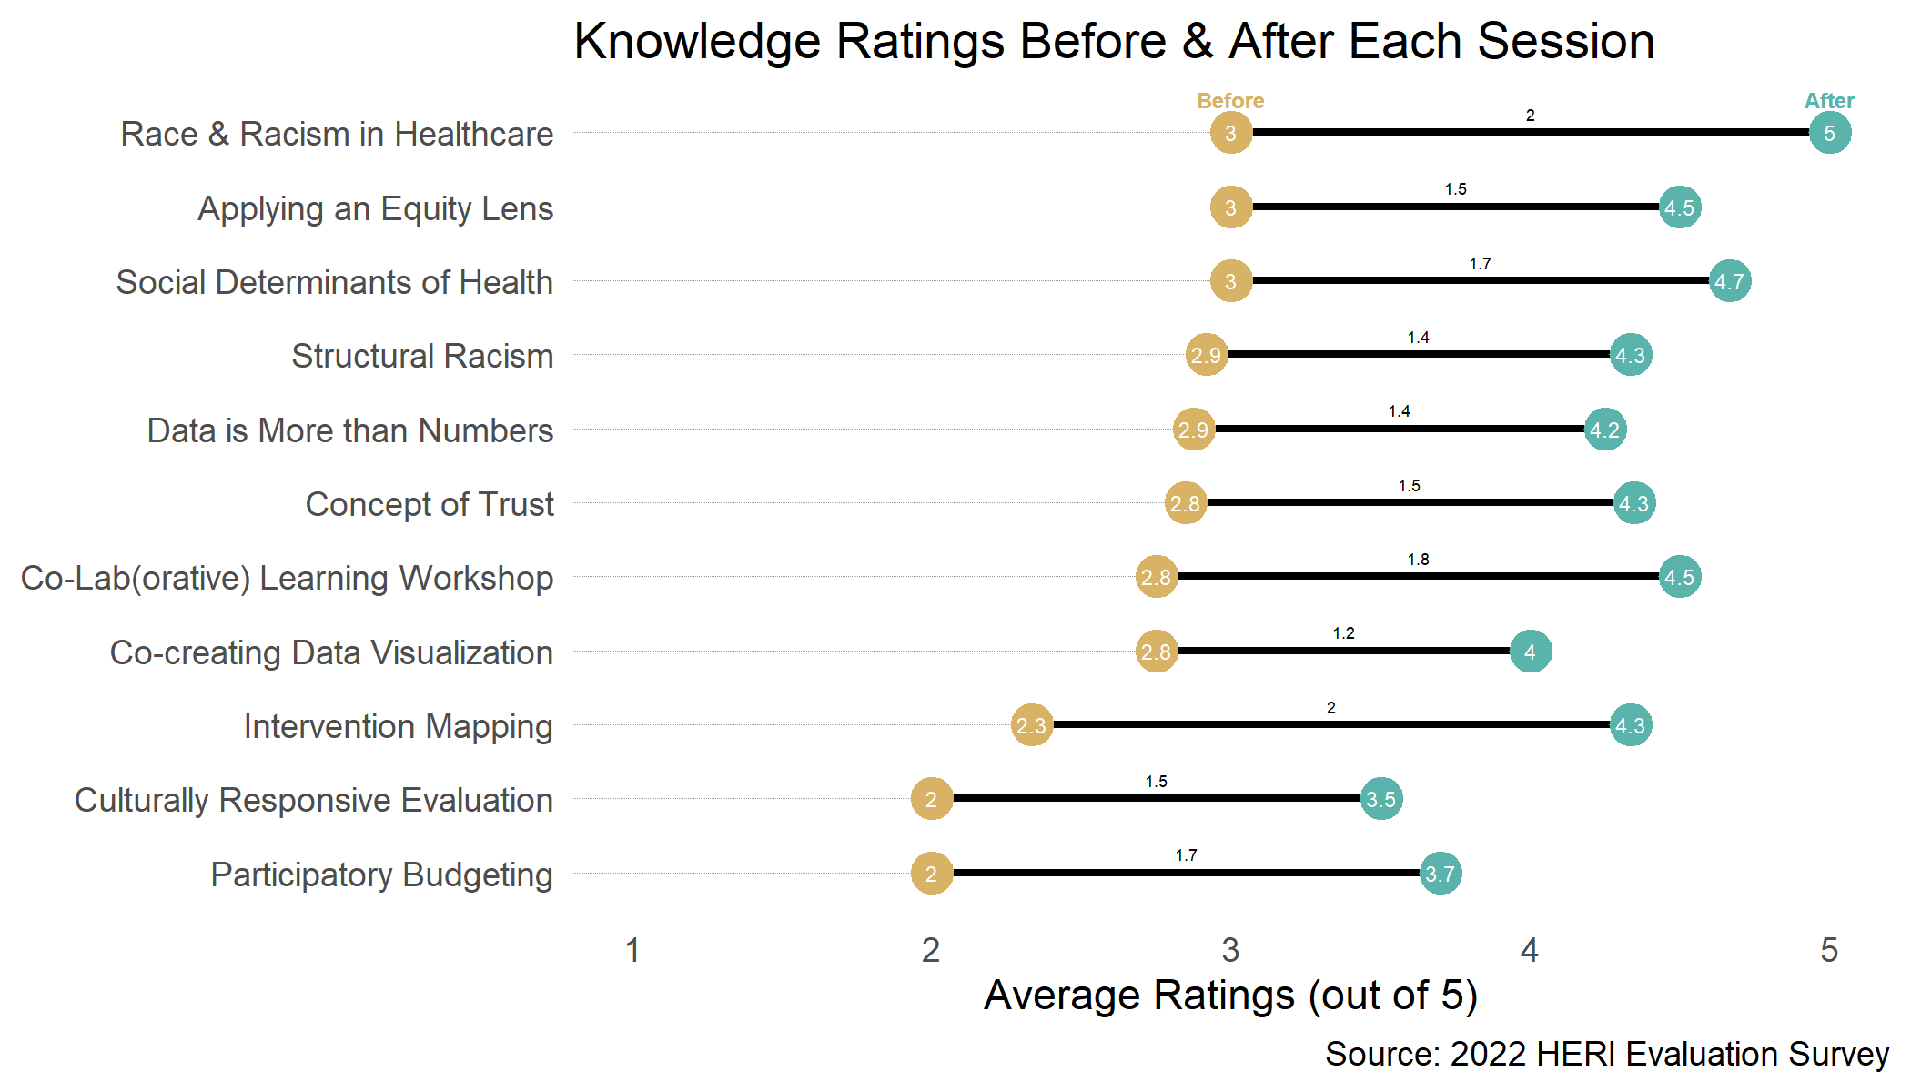
Generally, more gains in knowledge than ability per session
Only one respondent provided feedback in Session 6: Equitable Partnerships, and they did not complete the pre/post knowledge and ability items.
Notes:
Decrease in knowledge ratings after 3 sessions

Slide 7
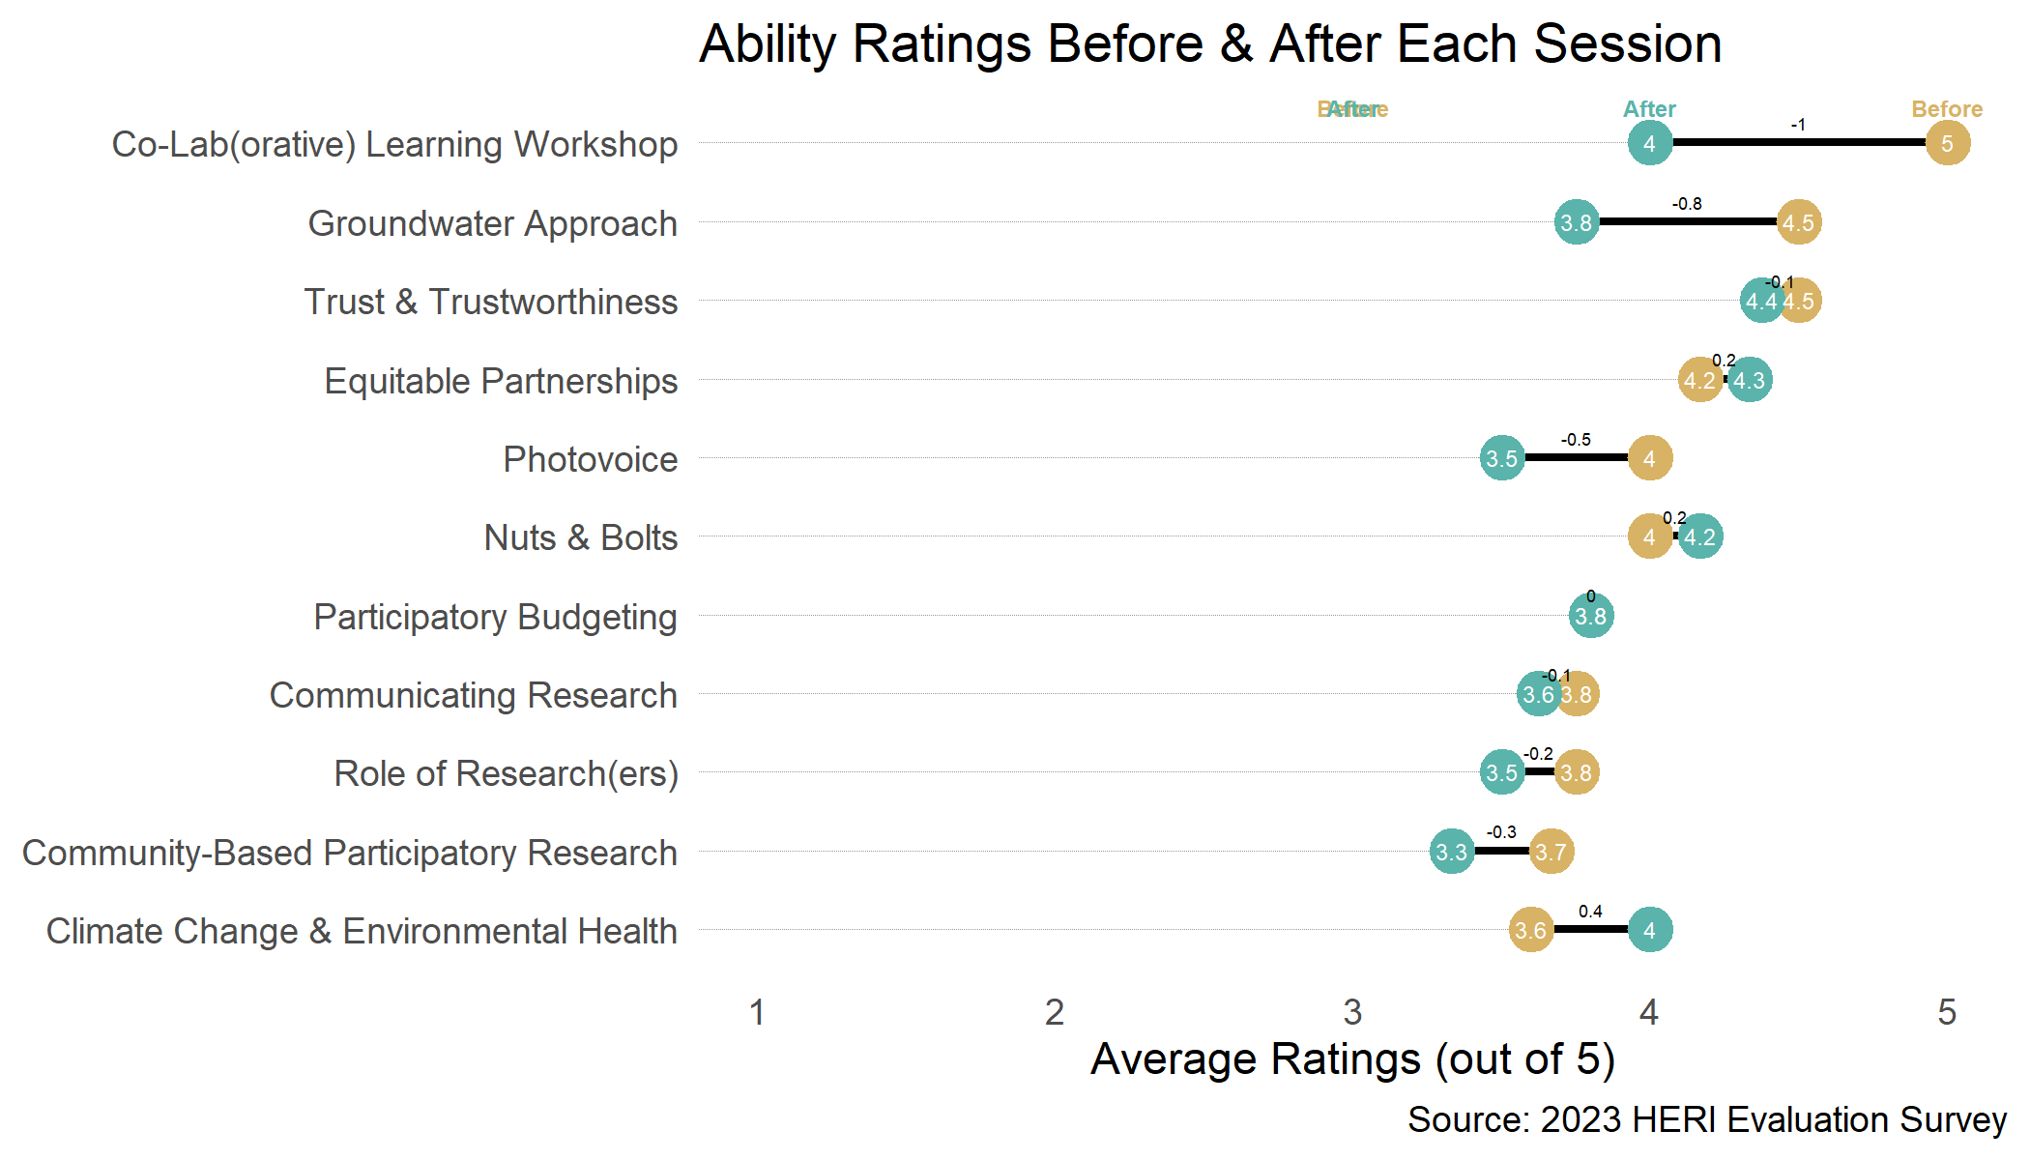
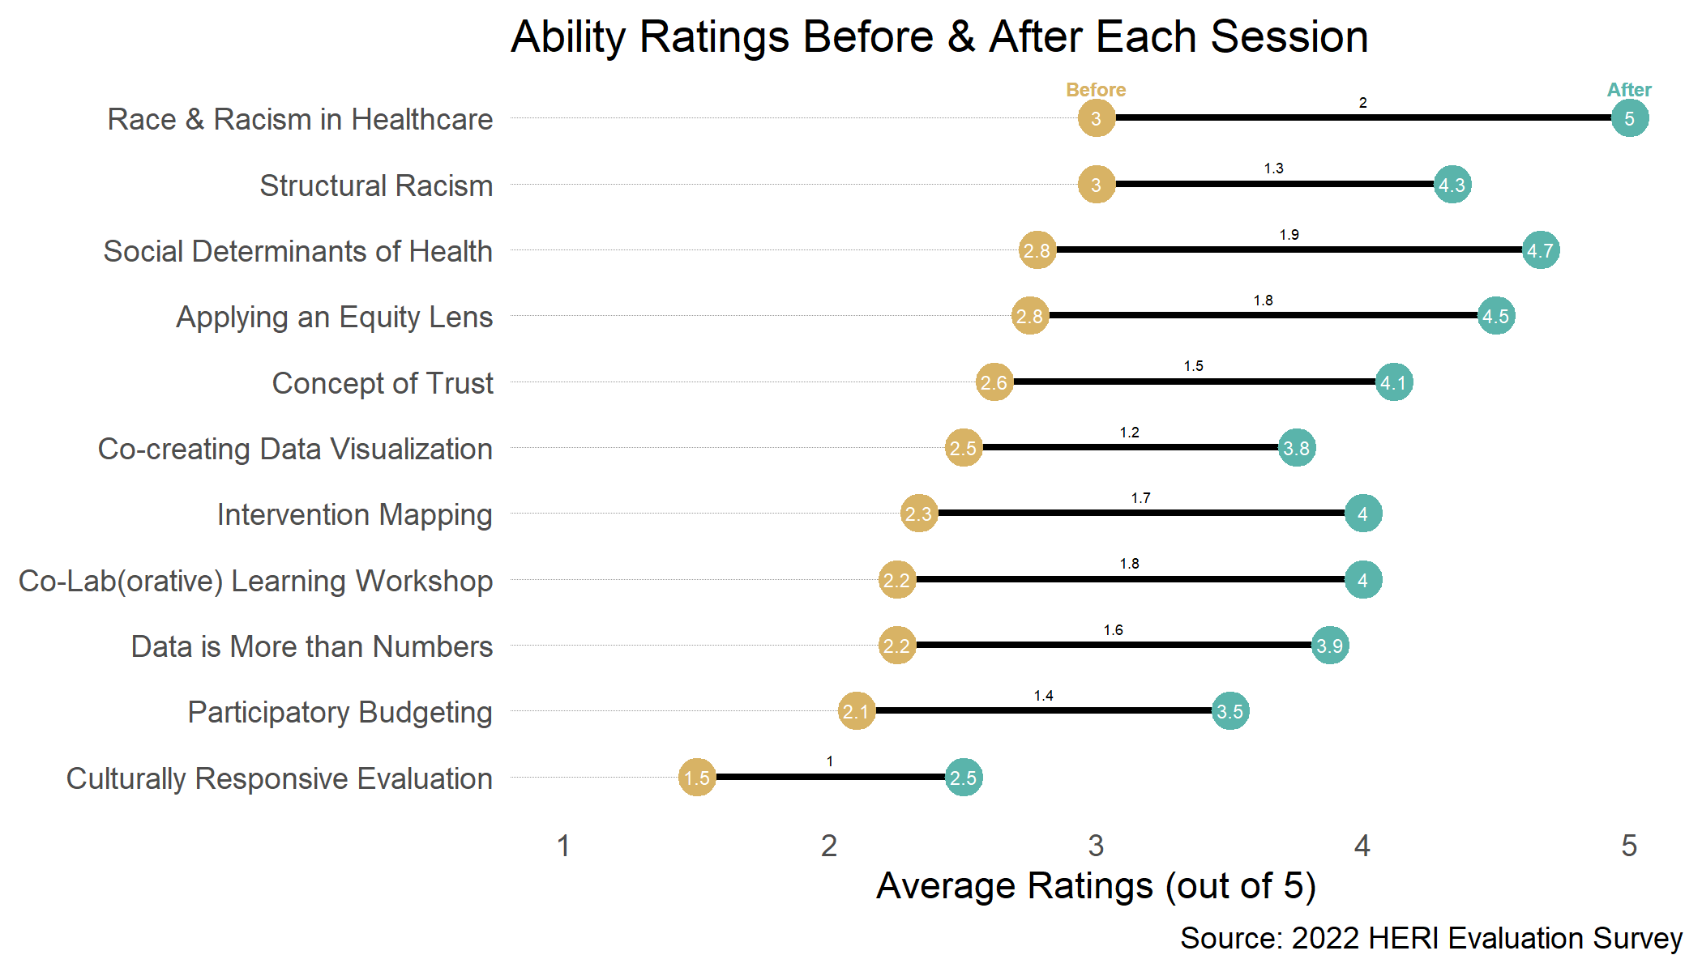
Only one respondent provided feedback in Session 6: Equitable Partnerships, and they did not complete the pre/post knowledge and ability items.
Notes:
Decrease in ability ratings after 7 sessions

Slide 8



PADLET
The most surprising thing I learned was...
"that researchers are just as excited about engagement of the community as we are with the researchers!"
that "...folks are still being treated differently due to the color of their skin“
I wish I had heard more about...
"how to do the things!..."
"...I would have loved to have more community members engaged..."
Environmental justice + BIPOC communities + health equity
Moving beyond the webinar
Facilitating a hub across community partners, coordinating a community calendar for researchers to attend community events for sustainable engagement
Notes:
3 HERI Staff (RH, RQ, JM) + 5 attendees = 8 (or 13.3% of) 60 calendar invitees

Slide 9
Evaluation Suggestions across Sessions (60 comments total)
More targeted content that accommodates a novice audience (and fits in the time allotted) using specific examples and diverse perspectives
More guidance in breakout sessions with clearer instructions and activities that are applicable to real-life scenarios
More ways to access extracurricular materials during the session & ensure slides are visually accessible
Notes:
https://miro.com/app/board/uXjVPZS3scY=/

Slide 10
Individual Session Results

Slide 11
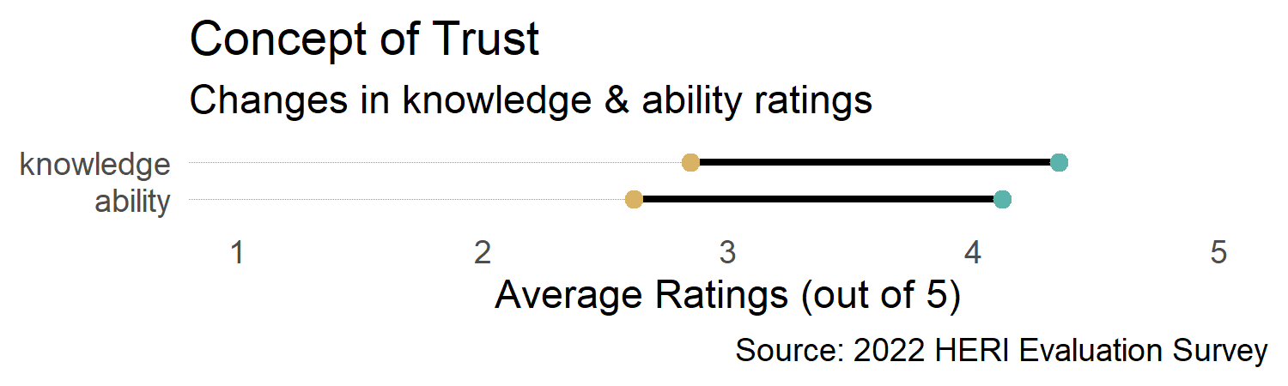
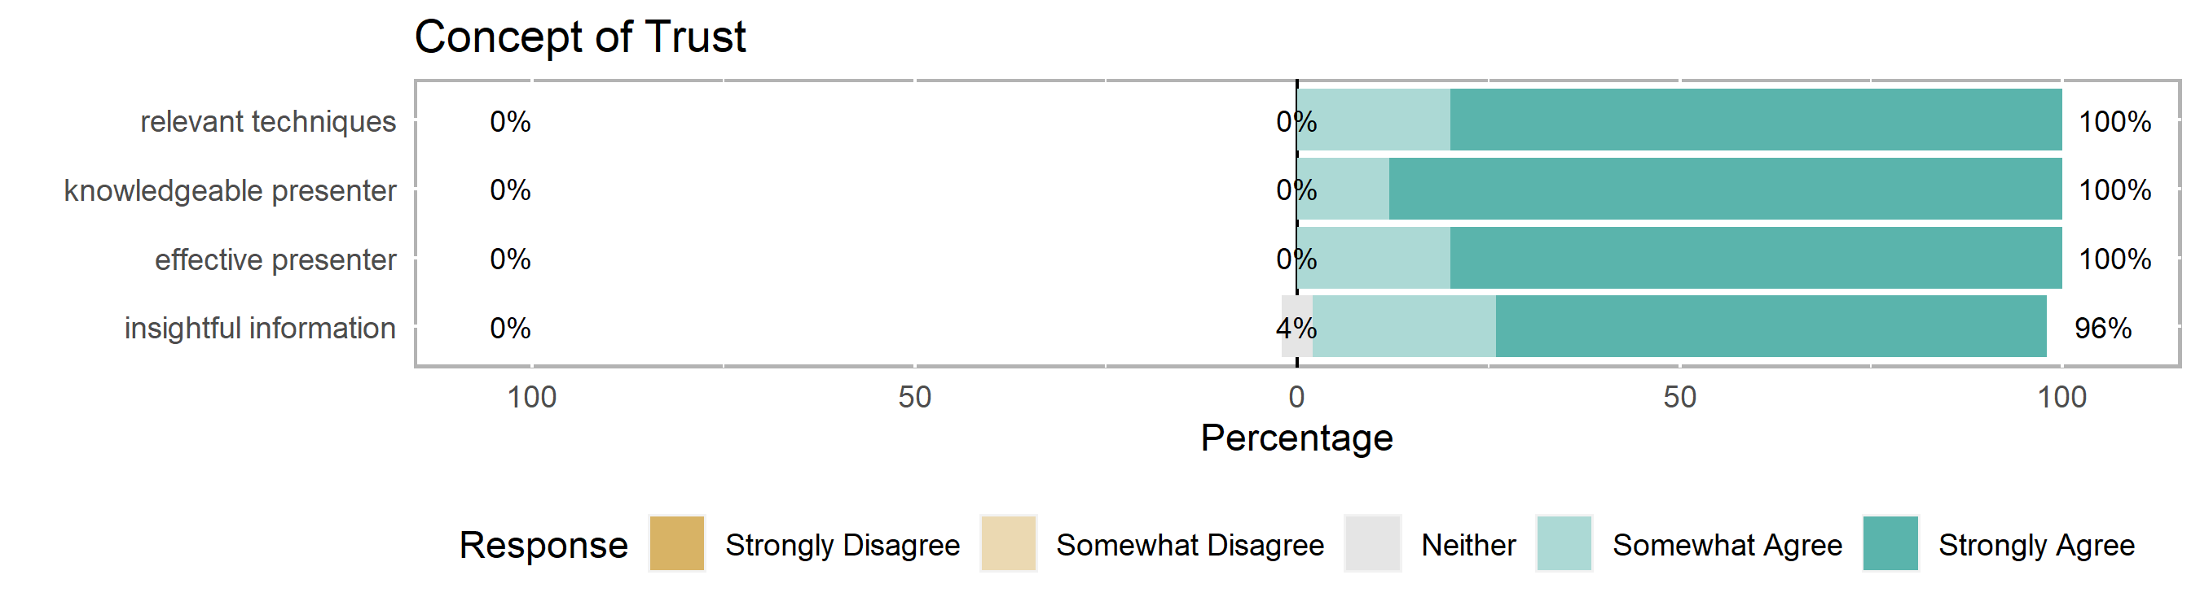
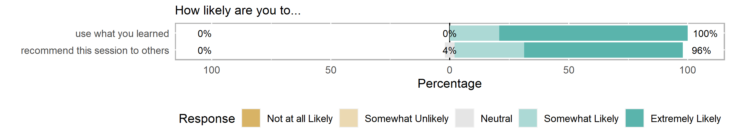
Concept of Trust in Health Equity Research (presented by Melissa Green)
4.4
Learning Objectives:
Analyze five determinants of trust within community-academic partnerships.
Initiate strategies to foster improved trust within community-academic partnerships.
Utilize give/get grid tool to support more equitable partnerships.
I would've loved to have heard directly from community members directly as a part of this session, perhaps as examples of each of the 5 pillars that they've experienced that worked well, and which ones didn't work well or fell short. (5 comments)
Perhaps having an additional way of sending/access (e.g., link and PDF) would be helpful in future. (2 comments)
The breakout session was very helpful. I think the instructions were a little unclear though on what to discuss. …Also, the 20min breakout felt a little long for our group for this session. (4 comments)
Health Equity Research Intensive 2022

Slide 12
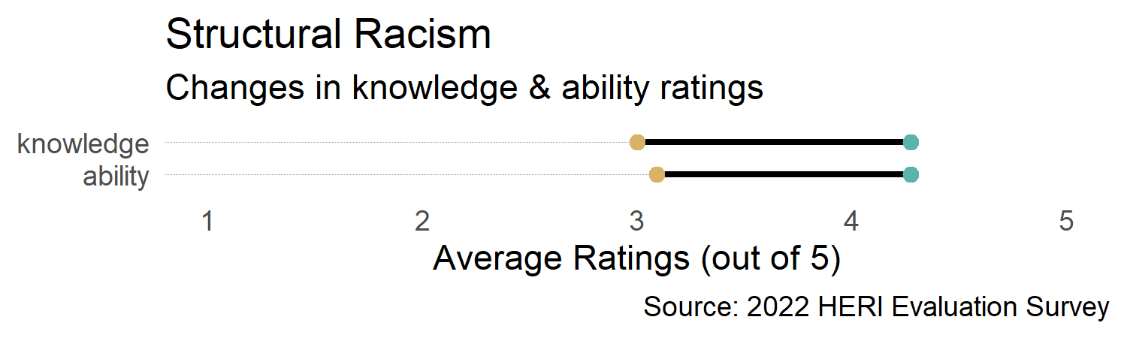
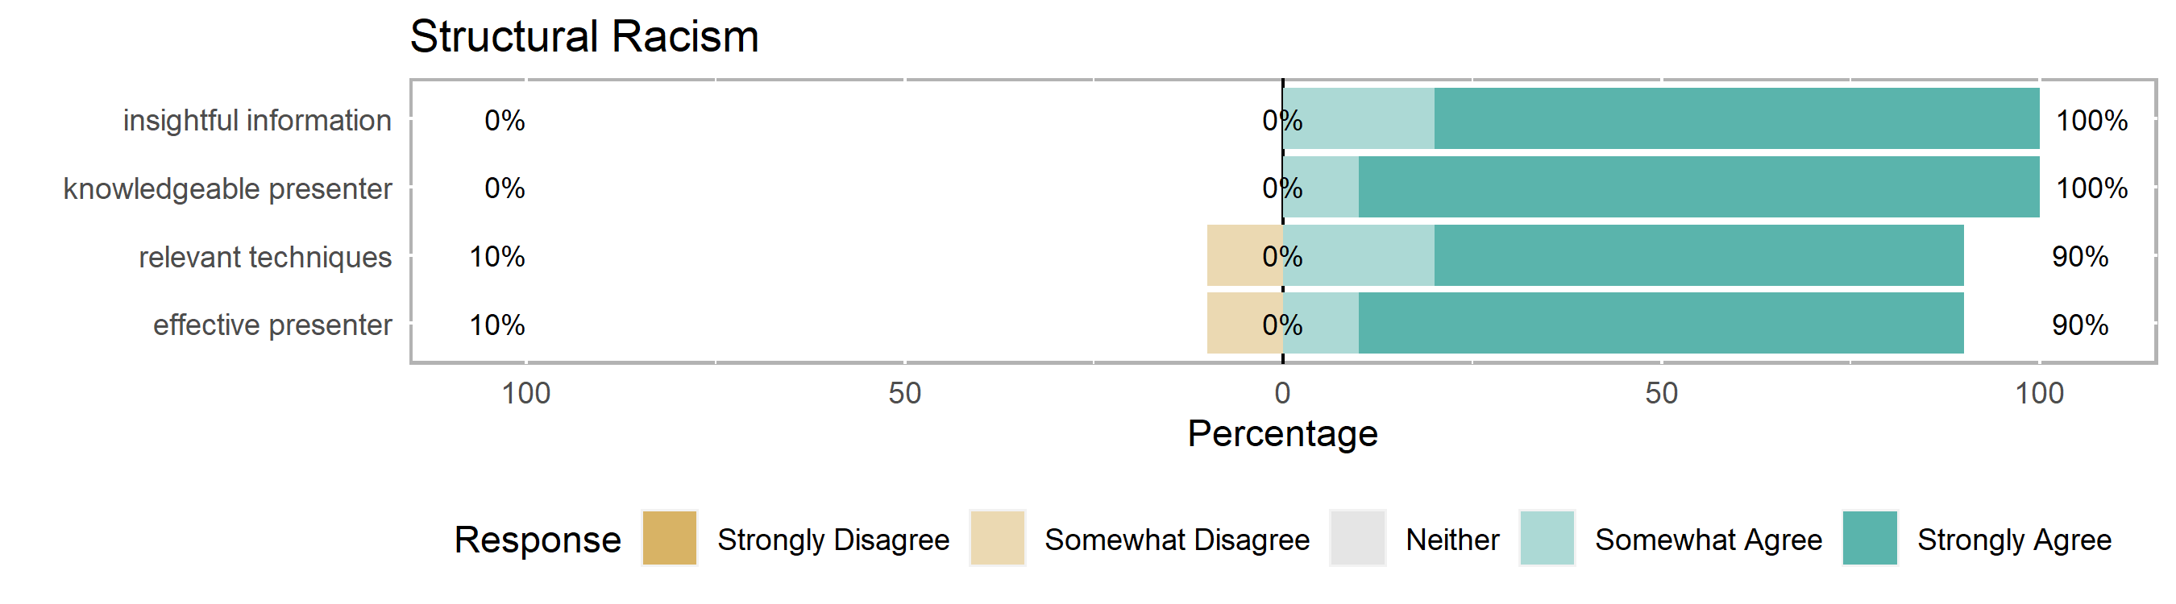
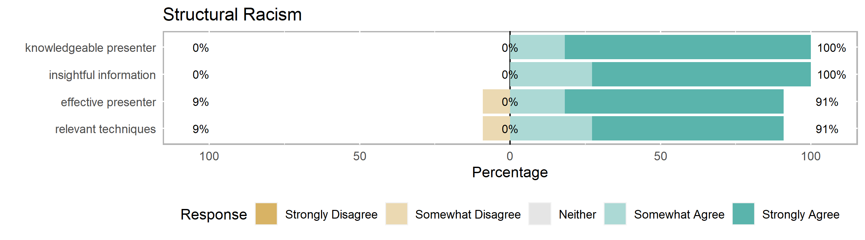
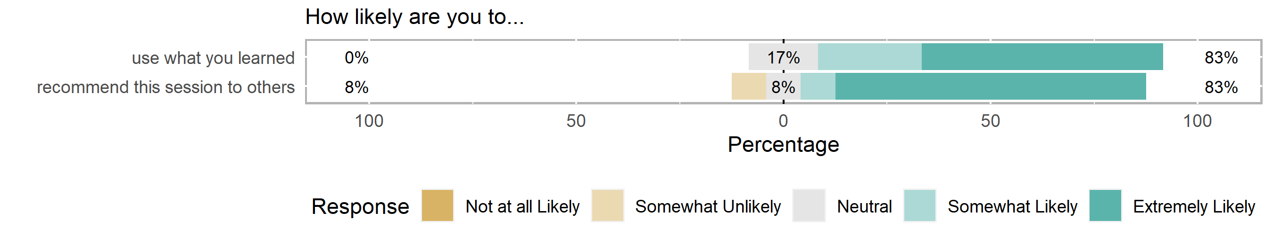
Structural Inequalities: The Deconstruction of Structural Racism: Making the Invisible Visible (presented by CCPH
4.5
Learning Objectives:
Discuss foundational ideas of race that promote systems of racism in the US.
Identify historical and contemporary manifestations of structural racism in the US.
Explore community engagement as a method to combat structural racism.
The lectures were very good for racial equity leveling…. I appreciate the many examples and the opportunity to get others' perspectives.
Prompts for breakout might work better with groups who have relationships already. The first one did not feel safe. It felt like a solicitation for confession. Later breakouts prompts were a little broad. (2 comments)
I would have loved to have met more community partners and wished the talk had more practical tips on making the invisible visible. (2 comments)
Health Equity Research Intensive 2022

Slide 13
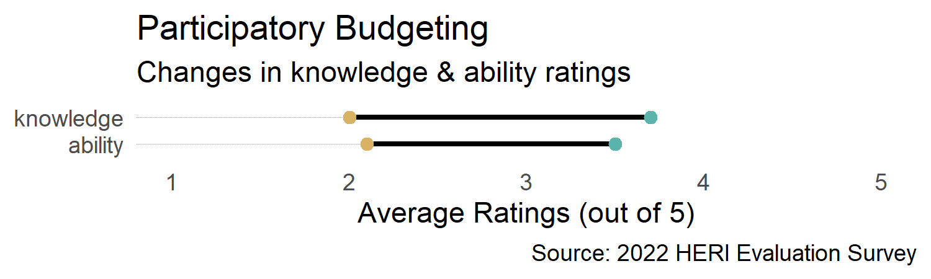
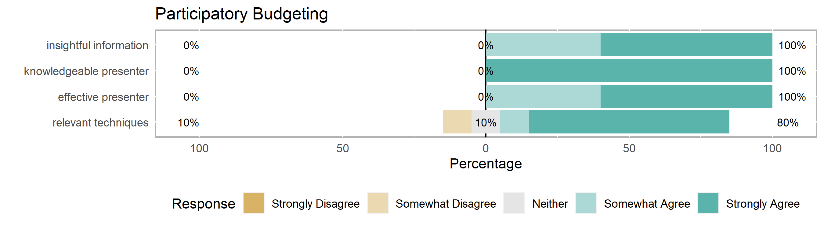
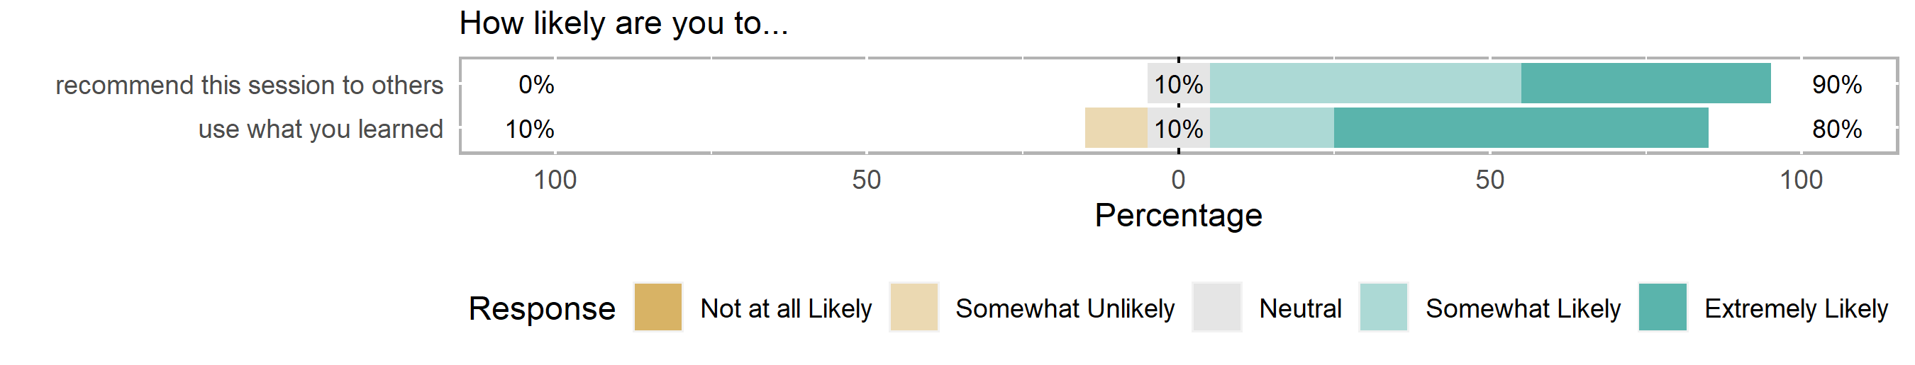
Participatory Budgeting (presented by Mysha Wynn & Melvin Jackson)
4.1
Learning Objectives:
Understand principles and practices of participatory budgeting.
Practice navigating common pitfalls of budgeting within community-academic partnerships (e.g., conflicts of interest, university and regulatory constraints, equitable resource management).
Learn to problem-solve and manage conflict about institutional constraints to participatory budgeting and fiscal management.
it needs to be more from a novice standpoint
(3 comments)
Add more time to each activity, …simplifying them… OR cut extra activities; provide more guidance in activity (e.g., what to focus on). I get the feeling they know this from hopping onto each room--which was super helpful! (5 comments)
It could be helpful to have a representative from OSP to discuss working on participatory budgeting from their perspective, too
(3 comments)
Health Equity Research Intensive 2022

Slide 14
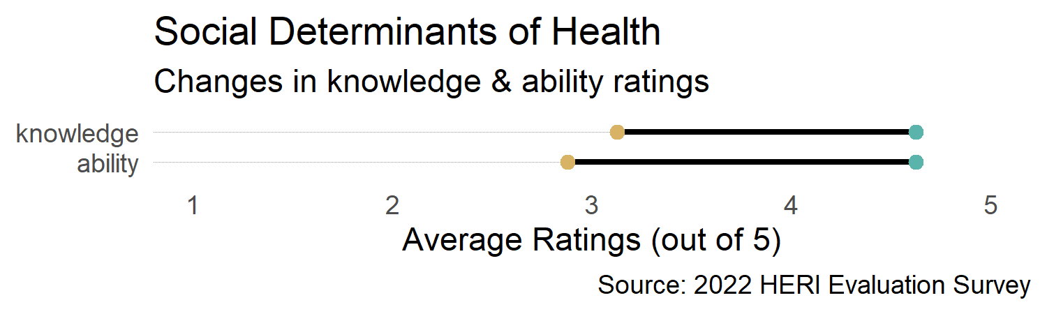
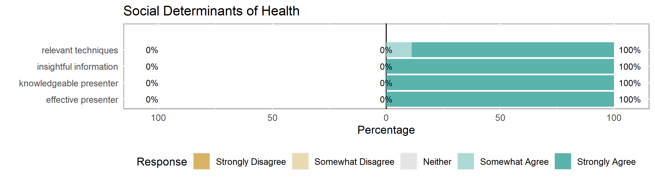
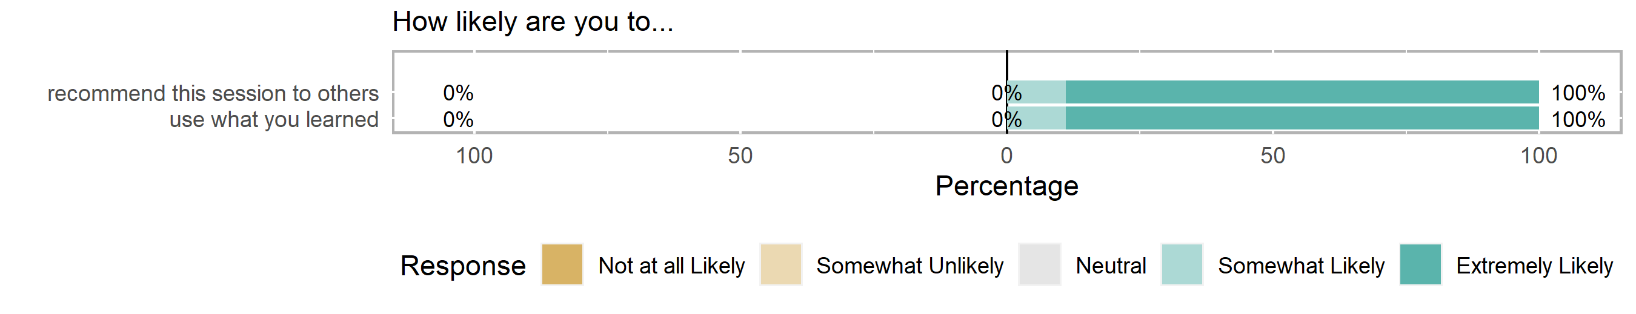
Social Determinants of Health (presented by Al Richmond & Giselle Corbie)
4.8
Learning Objectives:
Describe how conditions in the environments in which people are born, live, learn, work, play, worship, and age affect a wide range of health, functioning, and quality-of-life outcomes and risks.
Explore a life course perspective on health and illness.
Relate how improving the conditions in which individuals live, learn, work, and play can impact your research work.
This was my favorite course of Day 1, as it was rooted in theory and practical application in one.
Linking the determinants of potential interventions could be helpful if there were room.
Health Equity Research Intensive 2022

Slide 15
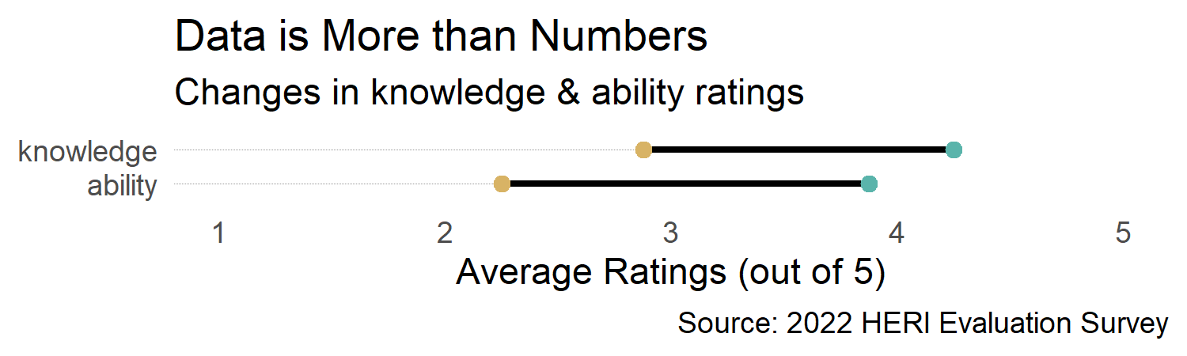
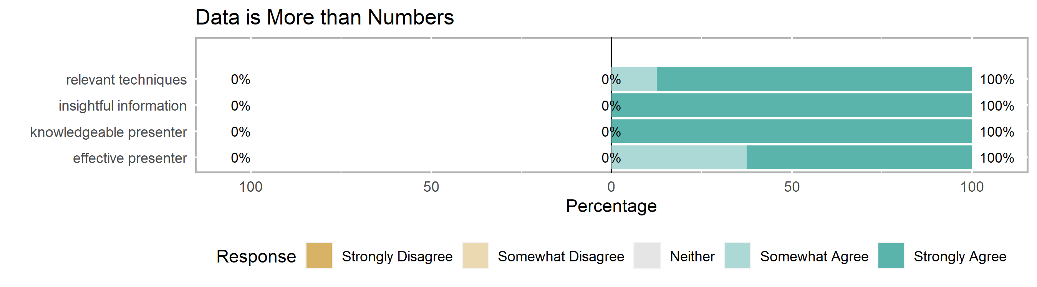
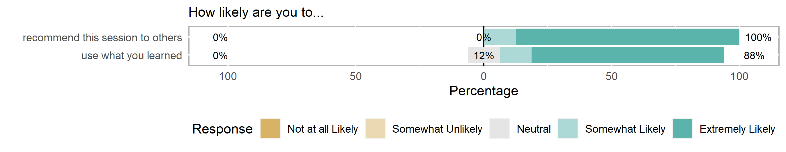
Data is More than Numbers: It’s the People That Count (presented by Kim Pevia & Jada Brooks)
4.9
Learning Objectives:
Deepen knowledge and understanding of authentic community engagement practices through critical self-examination.
Identify at least two methods or strategies to promote community collaboration throughout the data collection process.
Plan actionable steps to improve relationality between community and academic partners.
Please do offer this session again. Really special. …loved the modeled reflective writing, talking circles, mindfulness activity, somatics/bio breaks, and real-time conversation with presenters! and the timing was just right to make sure we had time to process and nothing got left behind
slides were difficult to see clearly
Health Equity Research Intensive 2022

Slide 16
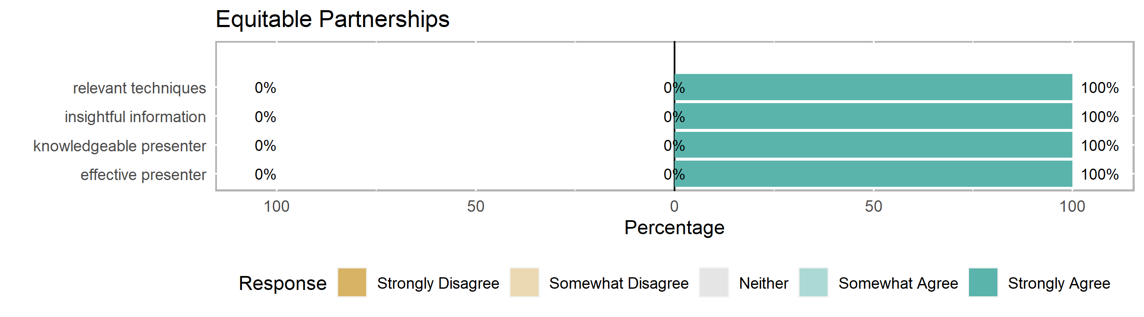
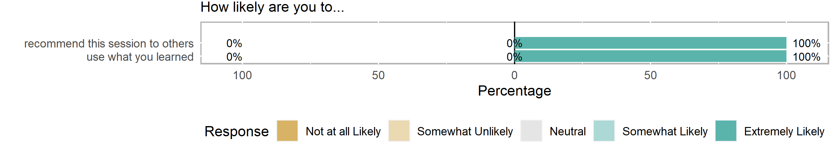
Principles of an Equitable Partnership (presented by Da’Naya Mayes, Trey Mackey & Charisse Iglesias)
4.0
Learning Objectives:
Recognize equitable power structures and resource structures.
Identify mutually beneficial relationships and community-centered approaches.
Explore methods to reduce silos and increase cross-sector collaboration.
Only one respondent provided feedback in Session 6: Equitable Partnerships, and they did not complete the pre/post knowledge and ability items.
(How do you believe being a participant in this training will help you in your work?)
Considering different types of reciprocity
Health Equity Research Intensive 2022

Slide 17
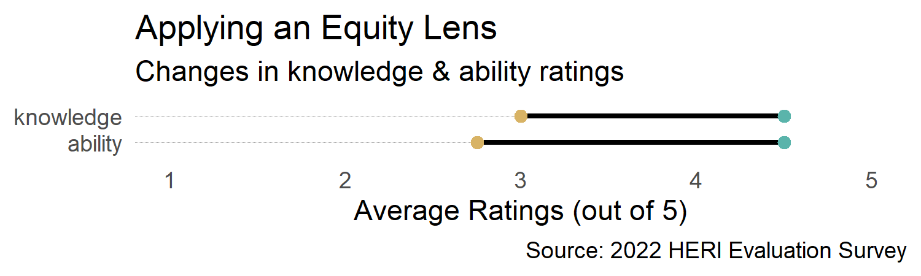
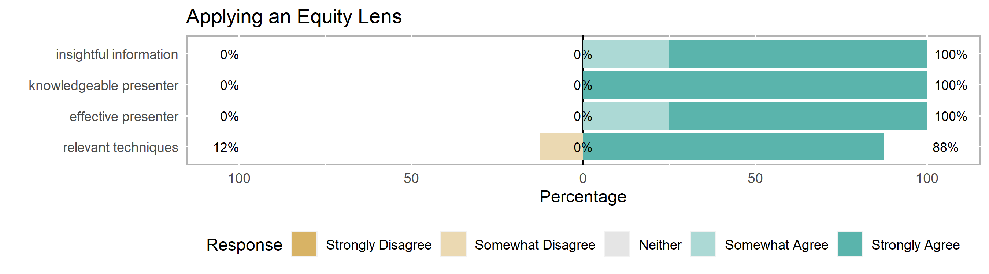
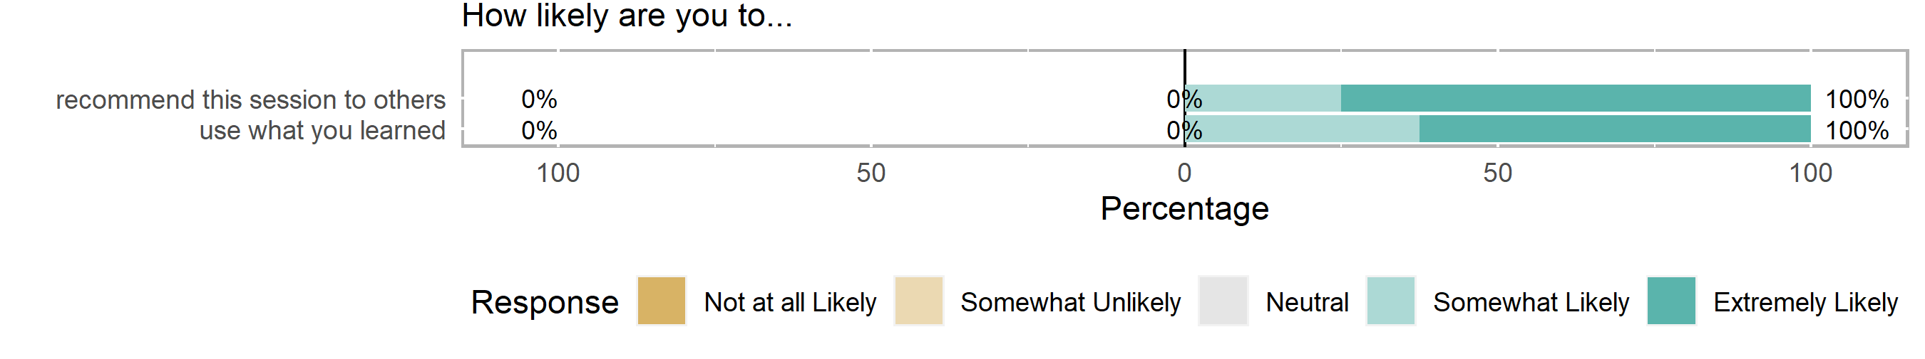
Applying an Equity Lens (presented by Giselle Corbie)
4.6
Learning Objectives:
Understand the importance of using a comprehensive framework to achieve health equity.
Apply elements of using a health equity framework in organizations.
Develop examples for each component of the framework to advance health equity
Discuss equity in research…and provide examples outside of the healthcare system and model
There was a lot of content and not enough time to get through it. In the future, it may be helpful to reduce the amount of content so that the end of the session does not feel rushed.
For breakout rooms, it would be helpful to have more guided discussion questions in addition to the main question we are trying to answer as a group.
Health Equity Research Intensive 2022

Slide 18
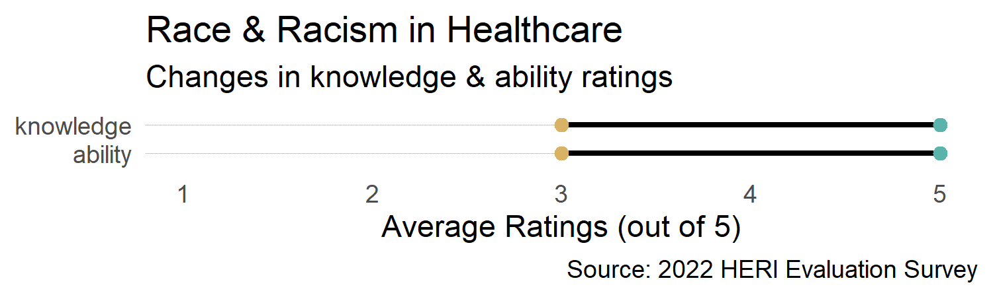
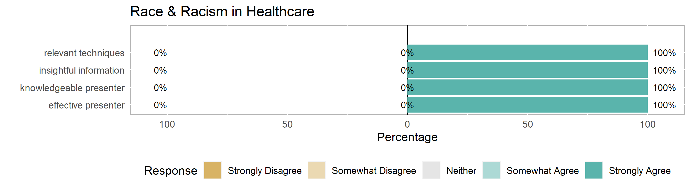
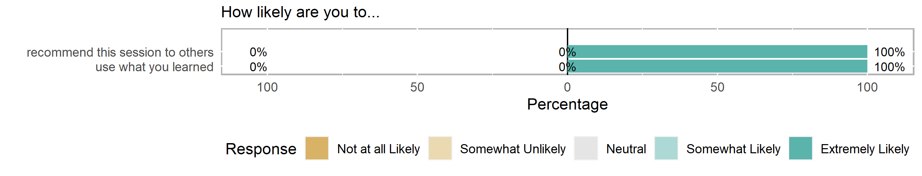
Race & Racism in Health Research – The Past & the Present (presented by Johanna Martinez)
5.0
Learning Objectives:
Compare and contrast the biologic vs. social construct of race.
Discuss the impacts of historical racism on patients, communities, health research and health professionals.
Identify how racism presents itself in modern health research and healthcare.
Incorporate anti-racist principles into individual practice and team-based research.
Bring her back next year!
Health Equity Research Intensive 2022

Slide 19
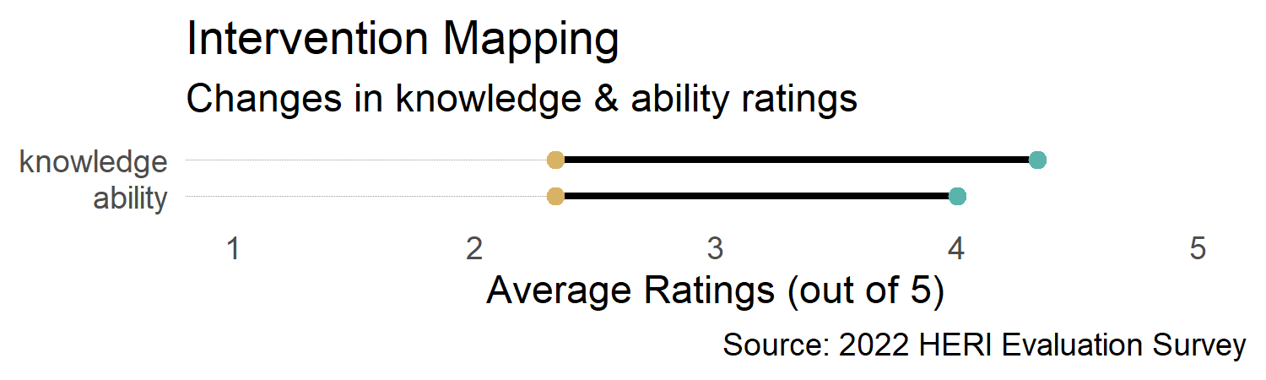
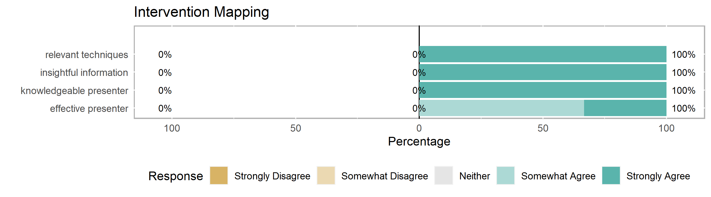
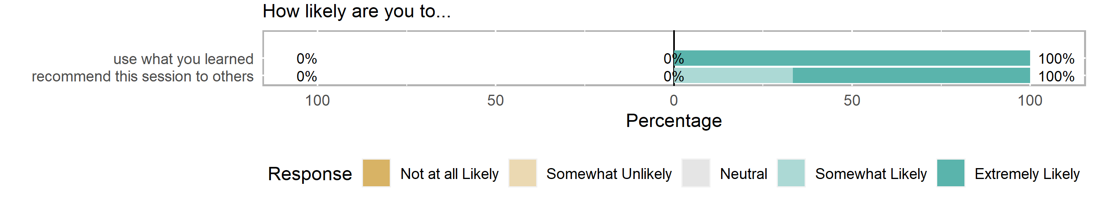
Intervention Mapping Approach to Adapt & Implement an Evidence-Based Community Based Intervention in Rural North Carolina (presented by Shirley MacFarlin & Gaurav Dave)
4.3
Learning Objectives:
Describe factors that affect the adaptation of a community-based prevention intervention in rural settings.
Describe factors that affect the implementation of a community-based prevention intervention in rural settings.
Describe vital elements of the intervention mapping and community-based participatory research approach to implement interventions in rural settings.
It seemed that too much was planned for the time allotted for the session. …spending less time on the background (Social change and CBPR introductions) and more time on the nitty gritty of the intervention mapping would be more helpful!
Health Equity Research Intensive 2022

Slide 20
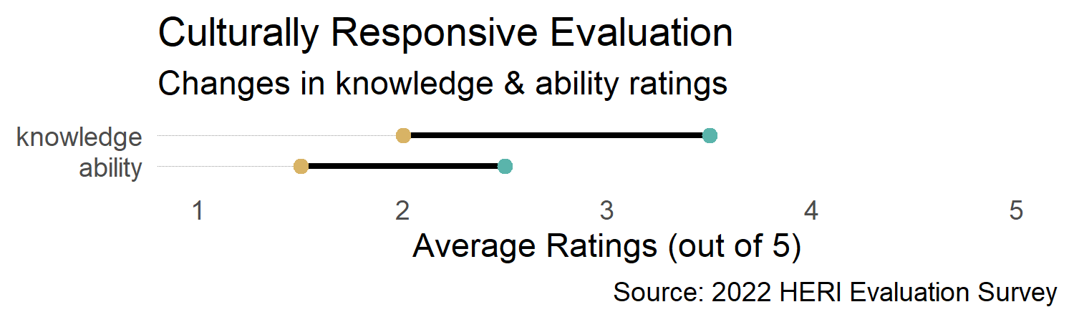
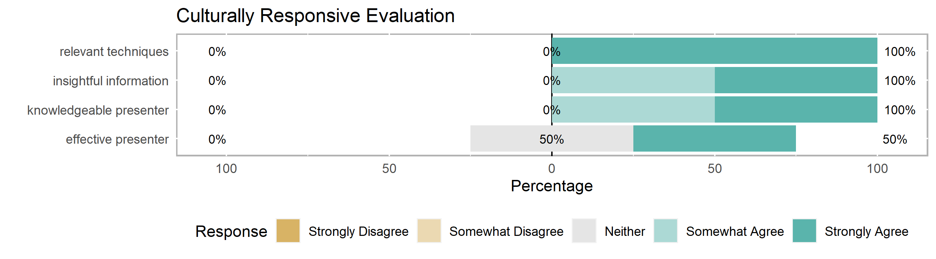
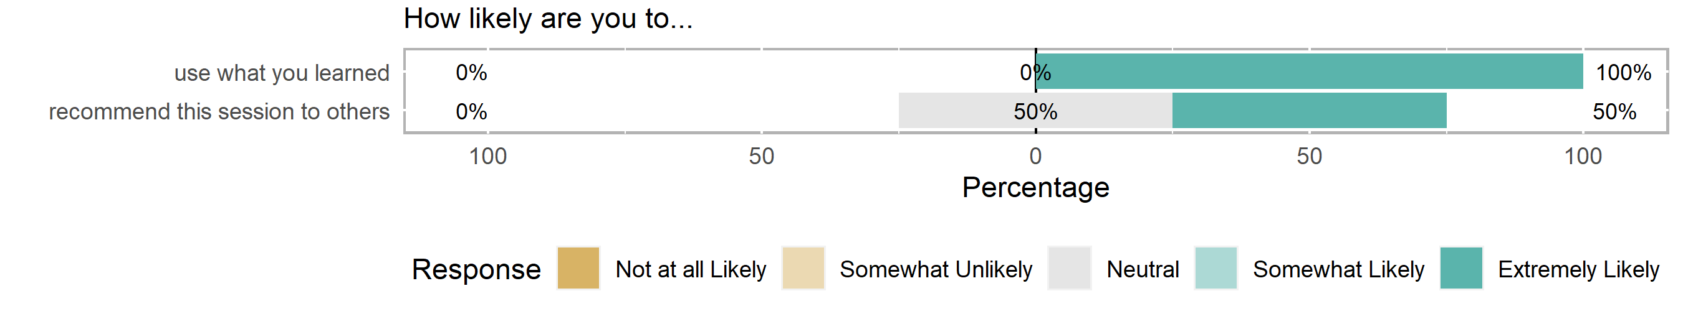
Is my Evaluation Culturally Responsive? (presented by Hope Bussenius)
3.5
Learning Objectives:
Assess the cultural competency of the evaluators and the evaluation process.
Discuss diversity as related to various grantee attributes.
Explore inclusion of members of the priority community in the evaluation process.
Identify equitable outcomes for the participants.
Great session! Appreciated the tool.
I could've used more guidance on the activities for an intentional, deep-dive into the toolkit.
Health Equity Research Intensive 2022

Slide 21
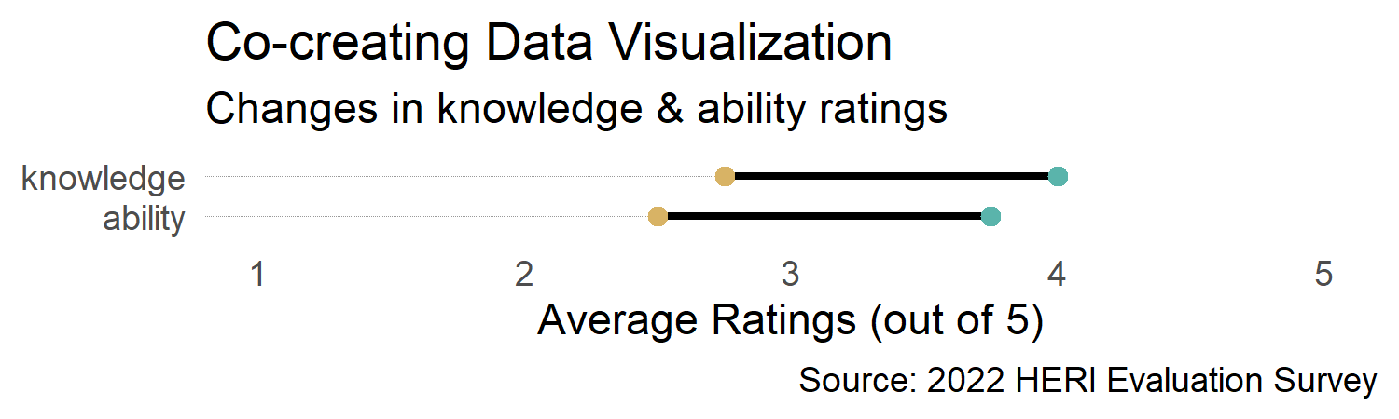
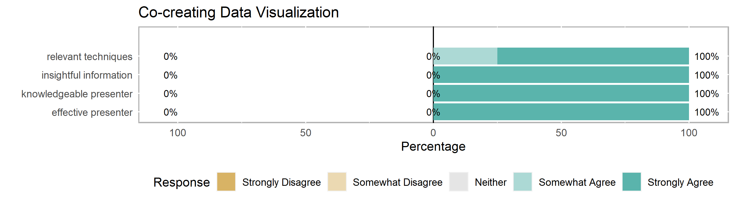

Engaging Communities in Co-Creating Data Visualization & Dissemination Strategies (presented by Brandy Farrar)
4.8
Learning Objectives:
Generate research questions likely to be most useful and of interest to communities engaged in research.
Apply multiple techniques for co-interpreting research findings.
Identify best practices in sharing research findings to community-based audiences.
I loved this session so much, as Brandy had great practical insights based on community needs for data visualizations. I'd love to have been provided some of the reference papers that her talk pulls from!
If there could be a follow-up applications-based workshop where we could bring our own data and crowdsource what ways are best to present that data, that would be interesting!
Health Equity Research Intensive 2022

Slide 22
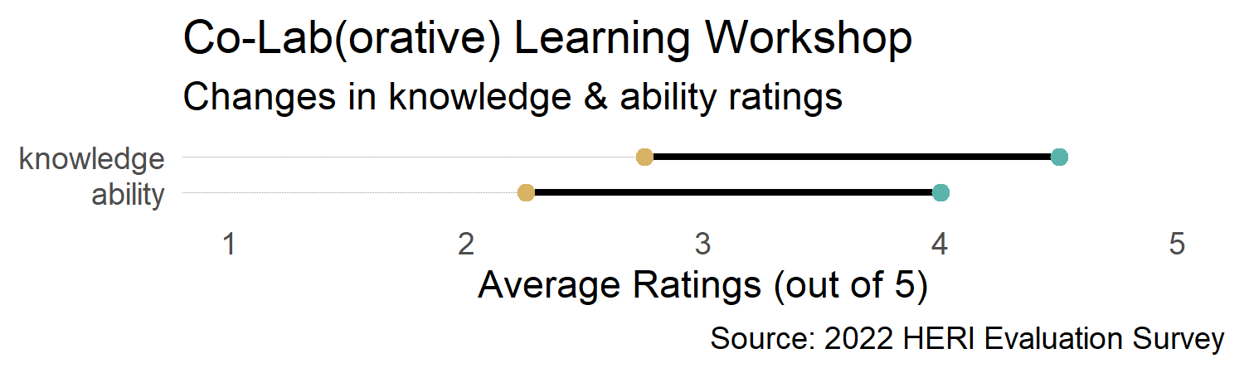
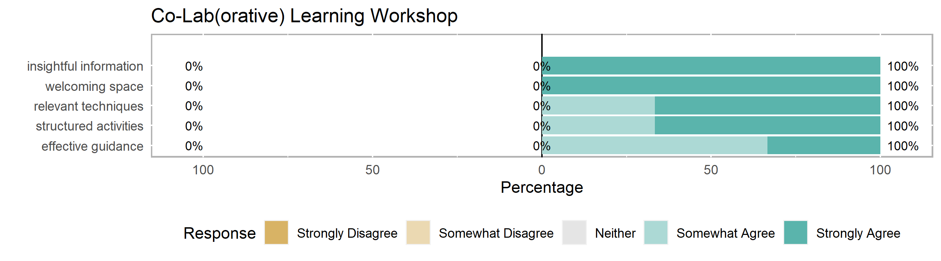

Co-Lab(orative) Learning Workshop (presented by Colleen Svoboda & Reilly Dow)
4.8
Learning Objectives:
Identify critical common barriers to inclusive research in NC and beyond
Collectively proposing local actions to create more inclusive research environments - in the community, research, and clinical settings
Miro (or other collaborative whiteboard apps) has templates that could facilitate these focused conversations in a one-stop-shop format. It's like a Padlet but groups can rearrange their sticky notes AND do dot voting.
A little more time in the breakout groups would be great. I had some very good conversations, but they were cut just a little short.
Health Equity Research Intensive 2022

